Slide 1

Sutton Middle School
Notes:
Good Morning/Afternoon! Today we begin the process of planning our school’s budget for FY23. I know we are all here for the same reason and that is ensuring success for all (enter school name) students. This meeting is to provide an overview of the draft budget and for you to give feedback on the draft budget.

Slide 2
Norms
This is a meeting of the GO Team. Only members of the team may participate in the discussion. Any members of the public present are here to quietly observe.
We will follow the agenda as noticed to the public and stay on task.
We invite and welcome contributions of every member and listen to each other.
We will respect all ideas and assume good intentions.

Slide 3

GO Team Budget Development Process
YOUR SCHOOL STRATEGIC PLAN…
is your roadmap and your role. It is your direction, your priorities, your vision, your present, your future.
Step 1: Data Review
Step 2: Strategic Plan Review
Step 3: Budget Parameters
Step 4: Budget Choices
Notes:
Today I will provide an overview of the budget allocations for FY23. We will begin the work of funding the strategic priorities we agreed upon during our strategic review meeting. (IF YOU HAVE NOT DECIDED ON YOUR PRIORITIES, YOU WILL SAY – WE WILL DECIDE ON OUR PRIORITIES AND THEN DISCUSS ALLOCATING FUNDS TO ADDRESS THOSE PRIORITIES).

Slide 4
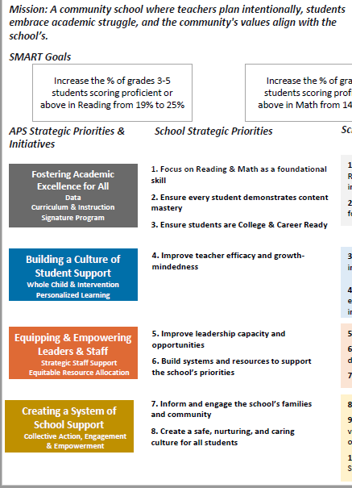
FY23 Budget Development Process
Principal’s Role
Design the budget and propose operational changes that can raise student achievement
Flesh out strategies, implement and manage them at the school level
Focus on the day-to-day operations
Serve as the expert on the school
Hire quality instructional and support personnel
The GO Team’s Role:
Focus on the big picture (positions and resources, not people)
Ensure that the budget is aligned to the school’s mission and vision and that resources are allocated to support key strategic priorities

Slide 5
Mission: Through the utilization of the International Baccalaureate program, Sutton Middle School aims to develop self-motivated, inquiring, knowledgeable, and caring young people, who are prepared to thrive academically and socially in high school, college, career and life
Sutton Middle School
Vision: A diverse, high performing school, that supports our students, educators, and families, rooted in a strong community, working together to improve student outcomes, intercultural understanding and make our communities a better and more equitable place.
SMART Goals
The percentage of proficient and distinguished scores on the EOG in Math by Black and Hispanic students will increase by 5%.
The percentage of proficient and distinguished scores on the EOG in ELA by Black and Hispanic students will increase by 5%.
Students will increase their self-awareness of their social and emotional needs, be able to self advocate, and appropriately handle stress, as measured by the BASC-3.
Stakeholder engagement will be supported through a minimum of one event a month that targets the needs of parents and community.
APS Strategic Priorities & Initiatives
School Strategic Priorities
School Strategies
Fostering Academic Excellence for All
Data
Curriculum & Instruction
Signature Program
Meeting the diverse needs of all learners.
Targeting instruction, remediation and interventions for our historically underperforming student sub groups. (Black, Hispanic, ESOL, and SWD).
1A. Implementation with fidelity of the Intervention/Enrichment Block (WIN).
1B. Implementation, support and professional learning to assure fidelity of Amplify ELA and Amplify Math.
1C. Implementation with fidelity of the International Baccalaureate Middle Years Programme to support all students in all content areas.
Using Social Emotional Learning to support all students.
Targeting supports for students who are struggling academically.
Providing supports to help students who are having Social and Emotional challenges.
2A. Weekly SEL lessons via the Second Step curriculum for all students.
2B. Daily WIN (What I Need Block) to provide targeted and individualized intervention and enrichment for students.
2C. Use of the BASC-3 screener for individual and group counseling supports for students.
Building a Culture of Student Support
Whole Child & Intervention
Personalized Learning
Equipping teachers with the resources needed to assure quality instruction and appropriate technology utilization.
Staffing the school to allow for student needs beyond academics to be met.
All teachers receive IBMYP sanctioned training within a year of hire and complete the Gifted endorsement, DLI, ESOL, or Reading endorsement within 3 years of hire.
3A. Using a collaborative approach to the budgeting process that includes input from staff, parents, and stakeholders.
3B. Ensuring staffing in areas outside academics that meets the needs of students (Counselors, SELTs, Administration, Operations, IB Coordinator, DLI/ESOL Coordinator)
3C. Each year assure a set aside of funds from the budget to meet training and endorsement needs.
Equipping & Empowering Leaders & Staff
Strategic Staff Support
Equitable Resource Allocation
Creating a System of School Support
Partnering with Families and Communities
Engage parents and community through effective outreach and community .
All families have access to school events and opportunities to support their student.
4a. Host a minimum of one parent event per month with bilingual Spanish translation at 50% of those.
4b. Provide access to school events in multiple modalities (live, zoom, recorded)
4c. Provide training and support for parents on supporting their students in all areas, SEL, technology and academically, with targeted outreach to sup- groups.

Slide 6
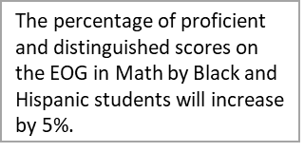
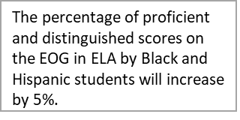
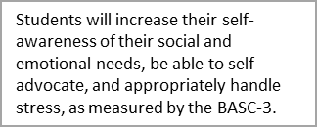

FY23 Priorities & SMART Goals
(From your Strategic Plan, insert your Top 2 Priorities & SMART Goals for FY23 here)
School Priorities
SMART Goals
Targeting instruction, remediation and interventions for our historically underperforming student sub groups. (Black, Hispanic, ESOL, and SWD).
Using Social Emotional Learning to support all students.
Notes:
Discuss priorities and rationale

Slide 7
FY23 Budget Parameters
FY23 School Priorities | Rationale
Close the achievement gap between white students and other student groups. | Sutton is proud of its diversity and all students must meet academic proficiency. We have an obligation to support all students and address historical gaps in academic achievement. All students must have equitable preparation for success in college, career, and life.
Notes:
Discuss priorities and rationale. After you have gone over the priorities and rationale – ask GO Team if this represents what was agreed upon.
Are there any priorities I left off?
Are there any questions or concerns?
The next time we meet, I will show you how I have allocated resources to support our strategic priorities.

Slide 8
Discussion of Budget Summary
(Step 4: Budget Choices)

Slide 9
Executive Summary
This budget represents an investment plan for our school’s students, employees and the community as a whole.
The budget recommendations are tied directly to the school’s strategic vision and direction.
The proposed budget for the general operations of the school are reflected at $13,774,981
This investment plan for FY23 accommodates a student population that is projected to be 1480 students, which is a decrease of 93 students from FY22.
Notes:
Here’s a few highlights for our budget this year – read executive summary

Slide 10
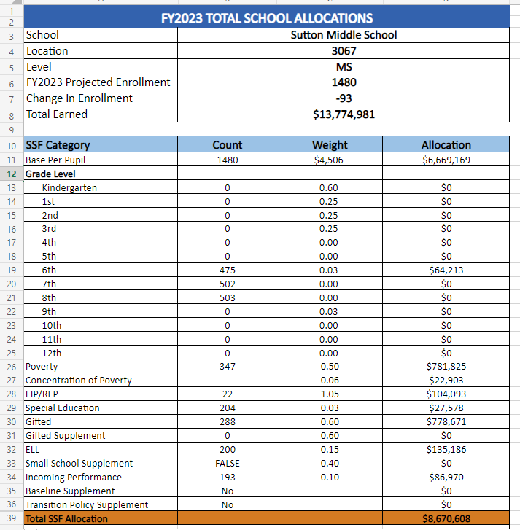
School Allocation
Notes:
For FY23, APS is continuing to increase equity within the District and the flexibility principals have in regards to our schools budgeted funds. The new Student Success Funding Model (SSF) allocates dollars to schools based on the number of enrolled students and receives a funding "weight" based on need. This year, student characteristics were weighted based on:
Grade Level –
K-12
Poverty – Weighted for all Direct Certification enrolled students.
Beginning Performance – Weighted Middle School and High School students entering with beginner’s performance on milestones.
ESOL – Weighted for all ESOL designated students in order to supplement due to ESOL staff being locked.
Special Education - Weighted for all Special Education students.
Gifted – Weighted and measured by number of students in the Gifted Program
Small School Supplement – Weighted for low enrollment schools
ES – 500
MS – 600
HS – 700
As you can see, our projected enrollment for FY23 is _______, we increased/decreased by __________ from last year.
We received the following weights for our student characteristics: (Below is just for the script, principals need to insert their school’s characteristics)
Grade Level
Poverty
Special Education
Gifted
Gifted Supplement
ELL
Small School Supplement

Slide 11
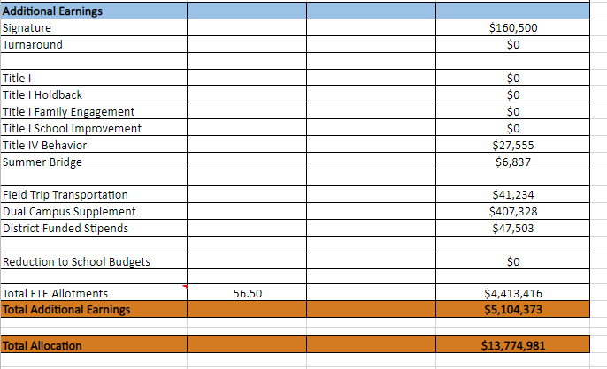
School Allocation
Notes:
Additionally, we received money for signature programming, turnaround, Title I and FTE Allotments.

Slide 12
Budget by Function (Required)
School | Sutton Middle School
Location | 3067
Level | MS
Principal | Ms. Gail Johnson
Projected Enrollment | 1480
Account | Account Description | FTE | Budget | Per Pupil
1000 | Instruction | 124.00 | $11,475,806 | $7,754
2100 | Pupil Services | 1.00 | $70,692 | $48
2210 | Improvement of Instructional Services | 1.00 | $106,578 | $72
2213 | Instructional Staff Training | - | $- | $-
2220 | Educational Media Services | 2.00 | $87,397 | $59
2400 | School Administration | 14.00 | $1,225,683 | $828
2600 | Maintenance & Operations | 10.00 | $554,052 | $374
2700 | Transportation | - | $- | $-
Total |  | 152.00 | $13,520,208 | $9,135
Notes:
I am passing out the definitions for these funding categories. You will see what makes up each category. Although the school’s total budget amount will not change, allocation per function may change depending on our conversations and school needs.

Slide 13
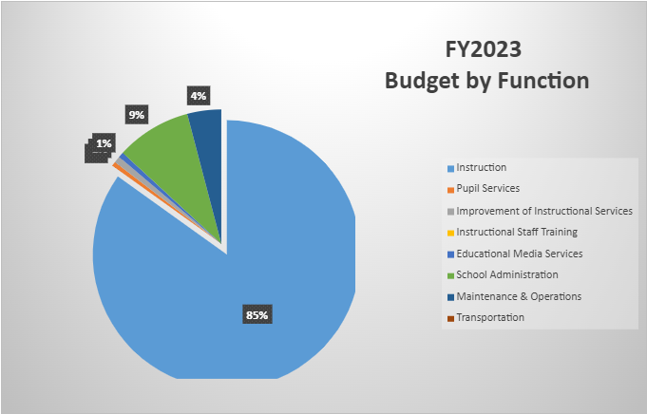
Budget by Function (Required)
Notes:
Explain the pie chart and allocations

Slide 14
School FY23 CARES Allocation
FY2023 ESSER III- CARES
School | Sutton Middle School
Location | 3067
Level | MS
Total Earned | $367,666
In addition to a General Fund allocation, our school has been allocated CARES funding that must be used to support implementation of the school-based intervention block and other school-based needs as a result of the COVID-19 Pandemic.
Once the support needed to implement our school-based intervention block/course has been fulfilled, we can use the remaining CARES funds to address other school-based needs that are a result of the COVID-19 Pandemic.
Notes:
Please add your school’s CARES Allocation to this slide.

Slide 15
CARES Allocations
Other allowable CARES expenditures include:
Technology Support: Software, assistive technology, online learning platforms, subscriptions.
Mental and Physical Health: Cover the costs of additional counseling, telehealth, therapeutic services, and wraparound services and supports (contracted hours, professional learning, programs)
Supplemental Learning: Cover costs of remediation, and/or enrichment opportunities during the school year for students (afterschool programs, additional pay for teachers and staff, transportation).
Professional Development: Cover costs of additional professional development for school leaders, teachers, and staff (trainings, extended professional development days, consultants, programs).
At-risk Student Populations: Cover costs of school specific activities, services, supports, programs, and/or targeted interventions directly addressing the needs of low-income students, students with disabilities, racial and ethnic minorities, English Learners, migrant students, students experiencing homelessness, and children in foster care.
Continuity of Core Staff and Services. Restore any potential LEA FY22 budget reductions due to decreased state and/or local revenue.

Slide 16
What’s Next?
January:
  GO Team Initial Budget Session (Jan. 13th-early February)
February:
  One-on-one Associate Superintendent discussions
  Cluster Planning Session (positions sharing, cluster alignment, etc.)
  Program Manager discussions and approvals
  GO Team Feedback Session
  HR Staffing Conferences (Late February - Early March)
• March:
  Final GO Team Approval (AFTER your school’s Staffing Conference- March 18th)
Notes:
In February, we will meet again to discuss how the school’s budget has been allocated to support the programmatic needs and FY23 key strategic priorities.
If think we need to continue our budget conversations, we will schedule additional meetings. My goal is to make sure your voices are reflected in our school’s budget.
I will also be meeting with my Associate Superintendent, program managers and other key leaders to go over our budget and to make sure the school is meeting the standards of service and appropriately staffing.
During the week of Feb. 24th -March 2nd , HR Staffing Conferences will be held. At this meeting, I will present my plan for staff utilization, resource distribution and plan for staffing implications.
We will need to approve the budget at the ________ meeting.

Slide 17

Questions?
Thank you for your time and attention.
Notes:
IF YOU FEEL YOUR TEAM IS READY TO APPROVE THE DRAFT BUDGET, PLEASE DO SO. PLEASE REMIND THEM THAT YOU MAY NEED TO MEET WITH THEM AGAIN, IF THERE ARE CHANGES FROM YOUR MEETINGS WITH DISTRICT LEADERSHIP. LET THEM KNOW YOU WILL KEEP THEM INFORMED!!

Slide 18
Slides to Complete After Your GO Team’s Initial Budget Meeting and After You’ve Met with Your Associate Supt. And Program Managers
(Steps 3 and 4 in the GO Team Budget Process)

Slide 19
FY23 Budget Parameters
FY23 School Priorities | Rationale
Close the achievement gap between white students and other student groups. | Sutton is proud of its diversity and all students must meet academic proficiency. We have an obligation to support all students and address historical gaps in academic achievement. All students must have equitable preparation for success in college, career, and life.
Notes:
Review the priorities that the GO Team has developed and the rationale for these priorities

Slide 20
FY23 Budget Parameters
FY23 School Priorities | Rationale
Targeting instruction, remediation and interventions for our historically underperforming student sub groups. (Black, Hispanic, ESOL, and SWD). | While Sutton’s overall school data is commendable, subgroup growth has stagnated, or, in some cases, regressed. It is our responsibility to address these trends.
Using Social Emotional Learning to support all students. | A combination of factors (pandemic, social media) has had a detrimental affect on students’ mental health and well-being. A robust SEL program informed by BASC-III will address these needs.
Notes:
Discuss priorities and rationale. After you have gone over the priorities and rationale – ask GO Team if this represents what was agreed upon.
Are there any priorities I left off?
Are there any questions or concerns?
The next time we meet, I will show you how I have allocated resources to support our strategic priorities.

Slide 21
Description of Strategic Plan Breakout Categories
Priorities– FY23 funding priorities from the school’s strategic plan, ranked by the order of importance.
APS Five Focus Area- What part of the APS Five is the priority aligned to?
Strategies – Lays out specific objectives for schools improvement.
Request – “The Ask”. What needs to be funded in order to support the strategy?
Amount- What is the cost associated with the Request?

Slide 22
FY23 Strategic Plan Break-out
Priorities | APS FIVE Focus Area | Strategies | Requests | Amount
Targeting instruction, remediation and interventions for our historically underperforming student sub groups. (Black, Hispanic, ESOL, and SWD). | Personalized Learning | Continued implementation of the personalized learning pilot program as well as Amplify and Read/Math 180. | Additional staff stipends and professional learning funds. | $80,000
Providing supports to help students who are having Social and Emotional challenges. | Whole Child + Intervention | Use of the BASC-III Data and small group interventions to diagnose and provide supports to struggling students. | Full-time Social Worker and School Psychologist. Professional Learning funds for teacher support. | $218,858
Notes:
For the next few slides, I will show you how I have allocated the budget to support our strategic priorities.
Based on our strategic priorities and funds we received, here is a break-out of the priorities, which focus area it addresses, the strategies that will be implemented, the purchase request, which funding source was used and the amount.

Slide 23
FY23 Strategic Plan Break-out
Priorities | APS FIVE Focus Area | Strategies | Requests | Amount
Equipping teachers with the resources needed to assure quality instruction and appropriate technology utilization. | Curriculum and Instruction | Upgrading 21st Century Classroom Spaces | Purchase of flexible seating, soundproofing, and E-Gaming equipment. | $75,000
Staffing the school to allow for student needs beyond academics to be met. | Whole Child + Intervention | Maintain support staffing (paraprofessionals, clerical, nurses, and media center personnel). | Maintain FY22 positions | $584,991
Meeting the diverse needs of all learners. | Data | Utilizing progress monitoring software, testing (MAP, Benchmark, HMH Inventories to assess student learning and differentiate instruction. | Renew progress monitoring purchases. Continue to hire highly qualified staff. | Software: $50,000 Teachers: $11,576,217
Notes:
For the next few slides, I will show you how I have allocated the budget to support our strategic priorities.
Based on our strategic priorities and funds we received, here is a break-out of the priorities, which focus area it addresses, the strategies that will be implemented, the purchase request, which funding source was used and the amount.

Slide 24
FY23 Strategic Plan Break-out
Priorities | APS FIVE Focus Area | Strategies | Requests | Amount
All teachers receive IBMYP sanctioned training within a year of hire and complete the Gifted endorsement, DLI, ESOL, or Reading endorsement within 3 years of hire. | Signature Programming | Offer a variety of professional learning to continue to build the MYP capacity of our teachers and to achieve reauthorization. Utilize the expertise of our current DLI staff to mentor the 7th grade DLI team. Implement best practices in screening potential new hires. | MYP Coordinator, Professional Learning Funds, Stipends for teacher leaders | $234,080
Notes:
Based on our strategic priorities and funds we received, here is a break-out of the priorities, which focus area it addresses, the strategies that will be implemented, the purchase request, which funding source was used and the amount.

Slide 25
Plan for FY23 Leveling Reserve
Priorities | APS Five Focus Area | Strategies | Requests | Amount
Using Social Emotional Learning to support all students. | Whole Child | Invite guest speakers and other area professionals for ongoing enrichment, motivational, and college/career planning workshops (such as the Latino Youth Conference). | Transportation, stipends, and speaker fees. | TBD
Notes:
This slides represent the priorities we will fund if we receive additional money from Title I and the Leveling Reserve. When we approve the budget we will approve both so that we will not have to schedule another meeting if the funds are made available.

Slide 26
Plan for FY23 CARES Allocation
Priorities | APS Five Focus Area | Strategies | Requests | Amount
Providing supports to help students who are having Social and Emotional challenges. | Whole Child | Relieve counselors’ caseloads by adding three behavior specialists. | Hire a behavior specialist for each grade level. | $328,287
Notes:
This slide represents the priorities we will fund during FY23 with our CARES 3 allotment.
Before I turn it back over to the Chair for the next slide, I want to thank you for your hard work and support this year. I will keep you informed as we move through the budget process. (Please inform Chair that they will facilitate the discussion for the last slide)

Slide 27
Questions for the GO Team to Consider
Are our school’s priorities (from your strategic plan) reflected in this budget?
  Are new positions and/or resources included in the budget to address our major priorities?
  Do we know (as a team) the plan to support implementation of these priorities beyond the budget (ex. What strategies will be implemented)?
  What tradeoffs are being made in order to support these priorities?
2. How are district and cluster priorities reflected in our budget?
  Cluster priorities- what staff, materials, etc. are dedicated to supporting our cluster’s priorities?
  Signature programs- what staff, materials, etc. are dedicated to supporting our signature program?
  Are there positions our school will share with another school, i.e. nurse, counselor?
Notes:
CHAIR - Our final task for today! Here are questions that we need to consider to ensure we have a good working draft budget. Let’s walk through them together.

